Slide 1
Introduction to Simulation and Modeling

Slide 2
Developing the Simulation Project Plan
(Lecture 10)

Slide 3
Developing the Simulation Project Plan
The project-planning process as a minimum consists of developing:
A work breakdown structure (WBS)
A linear responsibility chart (LRC)
A Gantt chart

Slide 4
Work Breakdown Structure
A work breakdown structure (WBS) is a successively lower division of project tasks into subtasks.
On the first or topmost level, the WBS might consist of only the nine simulation study steps
How many lower levels to use is at the discretion of the practitioner.
However, for the WBS to be meaningful, it is likely to require at least two levels.
The following outline illustrates a two-level WBS for a simulation project.

Slide 5
Organizing
1.0 Problem formulation
1.1 Orientation
1.2 Problem statement
1.3 Objectives
2.0 Project planning
2.1 Work breakdown structure
2.2 Linear responsibility chart
2.3 Gantt chart
3.0 System definition
3.1 Identify system components to model
3.2 Identify input and output variables
4.0 Input data collection
4.1 Collect data
4.2 Analyze data

Slide 6
1.0 Problem formulation 1.1 Orientation 1.2 Problem statement 1.3 Objectives 2.0 Project planning 2.1 Work breakdown structure 2.2 Linear responsibility chart 2.3 Gantt chart 3.0 System definition 3.1 Identify system components to model 3.2 Identify input and output variables 4.0 Input data collection 4.1 Collect data 4.2 Analyze data 5.0 Model translation 5.1 Select modeling language 5.2 High-level flow chart of model 5.3 Develop model in selected language | 6.0 Verification 6.1 Debug 6.2 Animate 7.0 Validation 7.1 Face validity 7.2 Statistical validity 8.0 Experimental design 8.1 Select model alternative configurations 8.2 Conduct production simulation runs 9.0 Analysis 9.1 Conduct t-test or analysis of variance 9.2 Conduct Duncan multiple-ranges test 10.0 Recommendations and conclusions 10.1 Recommendations 10.2 Conclusions

Slide 7
Linear Responsibility Charts
A simulation project is in need of a type of chart that illustrates the relationship between an activity on the WBS and the different individuals involved in the project.
The LRC shows who participates in each activity and to what degree.

Slide 8
Linear Responsibility Charts
The LRC can be superimposed on the existing WBS as the x axis going horizontally across the chart.
Across the top each individual’s name or title is listed.
There is an intersection between the vertical WBS tasks and the horizontal project personnel designations.
At each of these intersections, the project manager can place a code corresponding to the individuals’ level of participation.

Slide 9
Linear Responsibility Charts
P = primary responsibility
S = secondary responsibility
W = worker
A = approval
R = review
if an individual is not involved in a particular task at all, that intersection is simply left blank.

Slide 10
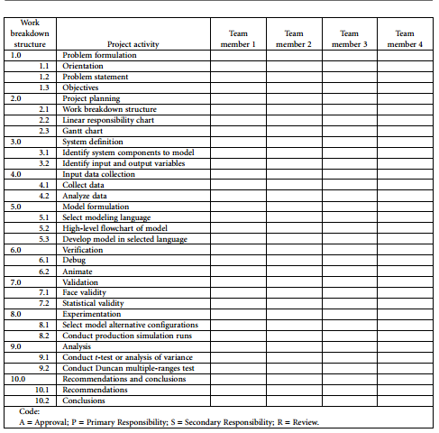
Linear Responsibility Chart

Slide 11
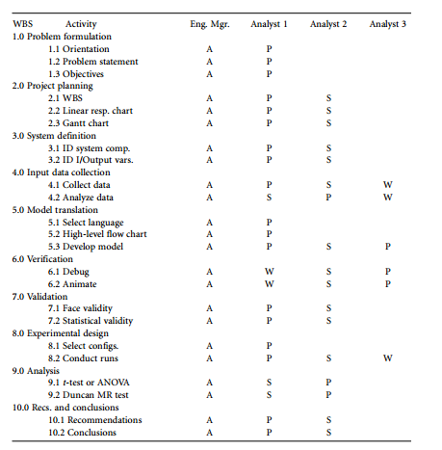
Linear Responsibility Charts

Slide 12
Scheduling and the Gantt Chart
we can use two different techniques in conjunction with each other. These techniques are:
1. Back planning
2. Gantt chart

Slide 13
Back Planning
When the decision is made to proceed with the project, the time parameter of the project can be defined by either a fixed duration or scheduled completion date.
In the event of a fixed duration period, there will also be a specified work start date.
Either way, a scheduled completion date can be calculated for the project.
The concept of back planning involves setting the completion date and working backward according to how much time is required for each of the tasks in the project.

Slide 14
Back Planning
If it turns out that the project requires a start date earlier than the current date, the estimate for the length of the individual project task lengths must be modified.
On the other hand, if it turns out that the start date is after the current date, two options exist.
The first option is to delay the project start until the scheduled start date.
The second alternative is to start the project on the current date and anticipate a completion date before the needed completion date

Slide 15
Gantt Chart
A Gantt chart illustrates the durations and relationships among different project activities.
The durations of individual tasks are represented by horizontal bars.
These are connections between the tasks that dictate what sequences must be observed between a preceding task and a succeeding task.
Common relationships include:
Finish to start
Start to start
Finish to finish

Slide 16
Finish-to-Start Relationship
It is necessary for the preceding task to finish before the succeeding task may start.
This type of relationship occurs in a simulation project between verification and validation.
  Verification: ensuring that the model operates as intended.
    having all the intended components in the model and debugging the model.
  Validation : ensuring that the model represents reality.
In order to test the model to see if it represents reality, if must first be complete and be able to run

Slide 17
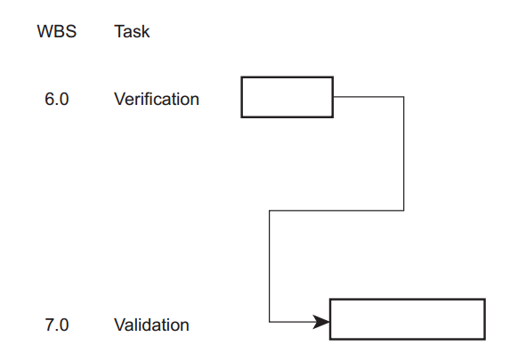
Finish-to-Start Relationship

Slide 18
Start-to-Start Relationship
Predecessor and the successor must start at the same time.
This sort of situation may occur when a single previous process splits into two different tasks that must be worked on simultaneously.

Slide 19
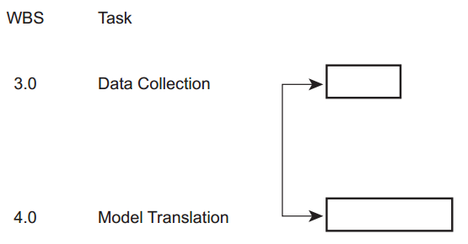
Start-to-Start Relationship

Slide 20
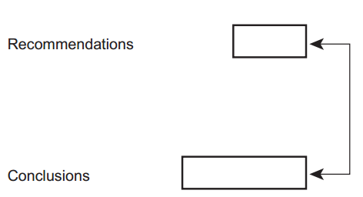
Finish-to-Finish Relationship
when both tasks are desired to be completed at the same time.
This means that if the tasks are of different duration, then the longer duration task must be started before the shorter-duration task.

Slide 21
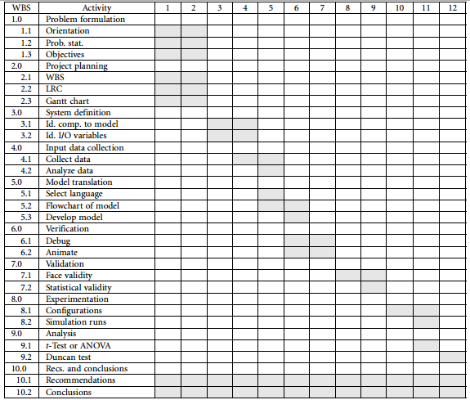
Example Gantt Chart

Slide 22
Summary
Any Questions?

